Slide 1
Descriptive and inferential statistical methodologies have proven effective in creating a proactive ‘alarm’, accurately identifying Pump Failures with Horse Power (HP) and Pump Efficiency (PE) emerging as key variables of interest with deviations of 15 HP and > 3 % PE being our core signal thresholds.
Notes:
The first slide we want to show is our overall conclusion showcasing that we have been able to effectively create a multivariate regressive equation that models Pump Failure.
On this slide, we would like you to show two charts: A) Using a line-series chart, show the Multivariate Regression Equation Values you’ve developed versus the Pump Failure (1 or 0)
B) Using a Column Chart, show the correlations ranked from highest-to-lowest for the Rolling Standard Deviation Dataset
Hint: The Chart you’ve created for the Inferential Statistics Tab, Q8 may be helpful.
You’ve created the chart for B) in Q6 so feel free to re-use this.
We’ve included an example on the right for the line chart and what it may look like.

Slide 2
Descriptive Analysis has enabled us to clearly identify particular signature abnormalities showing clear signature changes in both Rolling Standard Deviation and Rolling Mean Datasets when observed over the respective failure period of interest.
Notes:
The second slide now is starting to illustrate our story further. We will transition from Descriptive Statistics through to Inferential.
On this slide, we would like you to show two charts: A) Rolling Standard Deviation Plot
B) Rolling Mean Plot
Hint: The Chart you’ve created for the Descriptive Statistics Tab, Q3 may be helpful to complete this exercise.

Slide 3
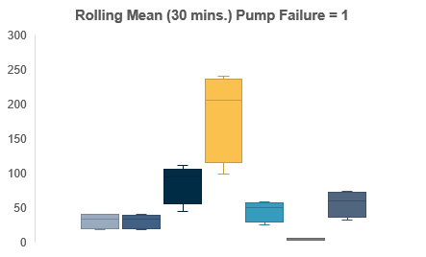
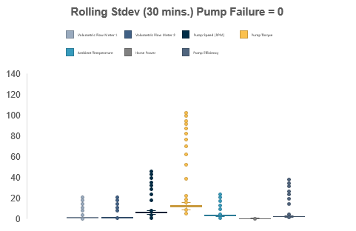
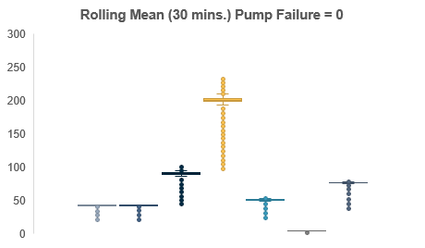
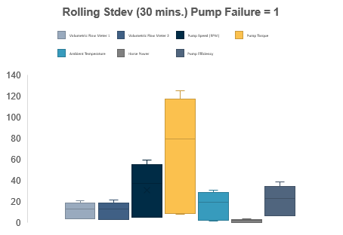
Further segmentation of the data via binary means (Pump Failure = 0 or 1) illustrated through Box and Whisker plots, show a clear signature difference between that of normal behaviour and that of Failure with Pump Torque, Pump Speed (RPM), Pump Efficiency showing the 3 largest variances.
Notes:
The third slide will illustrate how we have made use of descriptive statistics plot to identify which variables have exhibited the largest overall variances.
On this slide, we would like you to show four charts: A) Rolling Standard Deviation Plot (Pump Failure = 1)
B) Rolling Standard Deviation Plot (Pump Failure = 0)
C) Rolling Mean Plot (Pump Failure = 1)
D) Rolling Mean Plot (Pump Failure = 0)
Hint: The Chart you’ve created for the Descriptive Statistics Tab, Q4 may be helpful to complete this exercise.
We’ve included an example of what the descriptive statistics plots might look like on the right.

Slide 4
Correlation analyses across datasets yield interesting insights with Pump Efficiency and Vol. Flow Meter 1 & 2 negatively correlated with Pump Failure in the Rolling Mean Data, whilst Horse Power and Pump Efficiency show a subsequently strong positive correlation in the Rolling Stdev Dataset.
Notes:
The fourth slide will illustrate how we have made use of inferential statistics to identify which variables have exhibited the largest correlation spreads.
On this slide, we would like you to show three charts.
A) Raw Dataset Correlation against Pump Failure
B) Rolling Mean Dataset Correlation against Pump Failure
C) Rolling Standard Deviation Dataset Correlation against Pump Failure
Hint: The Correlation Heatmap’s you’ve created in Q5 on the Inferential Tab will be very helpful for this question. Don’t forget to reference the ‘Pump Failure (1 or 0)’ row for specifically the correlations related to this.
We’ve included an example of what the correlation plot for one of the datasets might look like for your reference.

Slide 5
Lastly, analysis of the model fit reveals that with a R Squared of 0.779, a linear model is a good fit for the data with variables Horse Power, Pump Efficiency, and Volumetric Flow Meter 2 having the largest coefficients, indicative that these variables have the most immediate relationship with respect to Pump Failure behaviour.
Notes:
The fifth and final slide will close out our story and showcase how we have identified which variables have the highest regression coefficients in our Multivariate Linear Regression Model.
On this slide, we would like you to show one chart:
Create a column-chart from the Multivariate Regression which shows the Regression Coefficients ordered from highest to lowest (i.e. The variable with the largest co-efficient has the highest rate-of-change with respect to Pump Failure)
Hint: Reference Q9 that you’ve completed in the Assignment to close out this presentation.

